Slide 1
Dynamic Analysis – Instrument Element
AVCDL-Implementation-8.1.2
Charles Wilson
Staff Product Cybersecurity Architect
version 6
2025-10-29
Notes:
Script:
I'm Charles Wilson, staff product cybersecurity architect at Torc Robotics.
This presentation will cover the Dynamic Analysis Element Instrumentation activity.

Slide 2
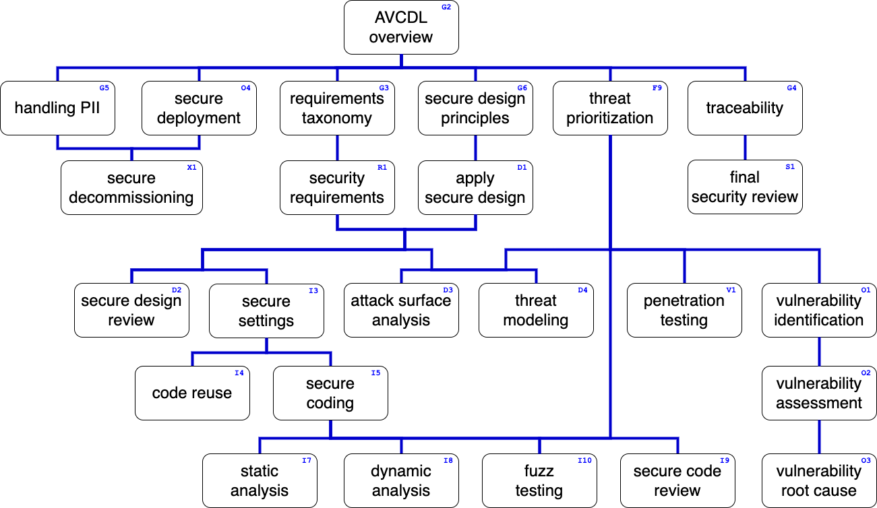
Training Path
Notes:
Script:
This diagram shows the overall AVCDL training path.
If you're taking this training, it's assumed that you've already completed the AVCDL Overview training,
and additionally, that you've completed the
Requirements Taxonomy
Security Requirements
Secure Design Principles
Apply Secure Design
Threat Prioritization
Secure Settings
Secure Coding
Dynamic Analysis Overview
and
Dynamic Analysis Establish Settings
trainings.
This training will cover Dynamic Analysis Element Instrumentation.

Slide 3
Introduction
Notes:
Script:
Before getting into element instrumentation, let's briefly review where it fits, in the overall dynamic analysis process.

Slide 4
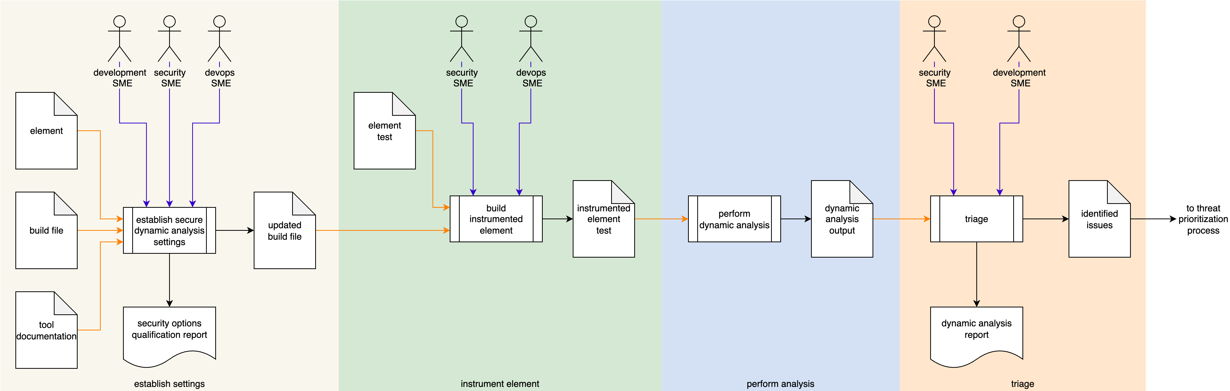
Dynamic Analysis Process
Notes:
Script:
Here's the dynamic analysis process which we previously covered in the Dynamic Analysis Overview.
[break]
Our focus for this training is going to be on the second activity, that of element instrumentation.

Slide 5
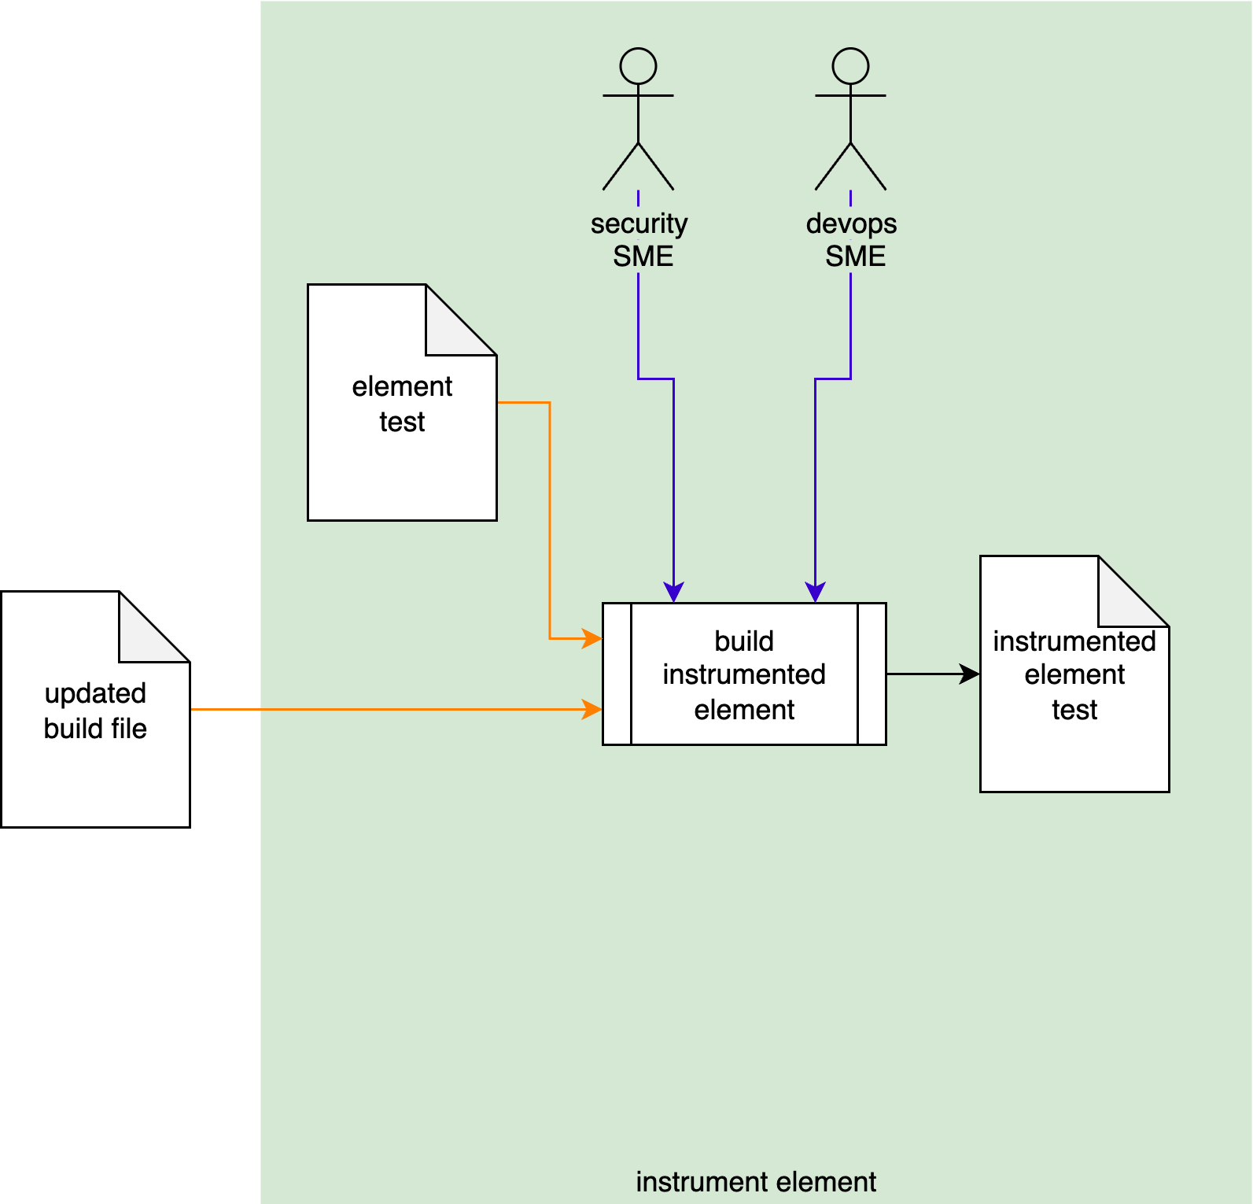
Dynamic Analysis Process
Notes:
Script:
Here's the dynamic analysis process which we previously covered in the Dynamic Analysis Overview.
[break]
Our focus for this training is going to be on the second activity, that of element instrumentation.

Slide 6
Instrument Element Activity
Notes:
Script:
Within the element instrumentation activity, the Security
[pause]
and DevOps SMEs take
[pause]
the updated build file created in the established settings activity,
[pause]
and the element test
[pause]
and make adjustments to allow for the dynamic analysis tool to perform its analysis activity,
[pause]
creating an instrumented element test.
[break]
Before we get into the methodology of how the element is going to be instrumented, let's talk about some points that are going to be relevant as we go through this activity.
[pause]
The first of which is that the element test may not exist.
Just because you have a generalized QA process which includes automated tests, doesn't mean that there's going to be one for this particular element that the dynamic analysis is going to be able to leverage.
[pause]
The second aspect is with regards to the updated build file.
It's important that there be a separate test build which is not going to be burdened by either over-diagnostics found in a pure debug build, because that's going to have impact on both timing and memory.
Nor do you want this to be a release or production build because none of this should actually ever go into anything dealing with that and in the context of production builds, the options that have been chosen for compilation and linking may have impacts on the dynamic analysis tools ability to be able to be used effectively.
[pause]
Next, the DevOps SME, as shown here, may be an optional player.
That's going to depend on how the build system operates and what sort of levers need to be adjusted in order to handle the instrumentation process.
[pause]
Similarly to the element test coming in, the instrumented element test going out is going to be contingent on there being an element test that you're starting with.
So, this may need to be completely spun up, which is going to impact how the process goes forward.
[pause]
And the final thing is that we want to ensure that regardless of what changes we make, we pre-flight them to ensure that they don't break the CI/CD system.

Slide 7
Instrument Element Activity
may not exist
may be optional
may not exist
only test builds
preflight
Notes:
Script:
Within the element instrumentation activity, the Security
[pause]
and DevOps SMEs take
[pause]
the updated build file created in the established settings activity,
[pause]
and the element test
[pause]
and make adjustments to allow for the dynamic analysis tool to perform its analysis activity,
[pause]
creating an instrumented element test.
[break]
Before we get into the methodology of how the element is going to be instrumented, let's talk about some points that are going to be relevant as we go through this activity.
[pause]
The first of which is that the element test may not exist.
Just because you have a generalized QA process which includes automated tests, doesn't mean that there's going to be one for this particular element that the dynamic analysis is going to be able to leverage.
[pause]
The second aspect is with regards to the updated build file.
It's important that there be a separate test build which is not going to be burdened by either over-diagnostics found in a pure debug build, because that's going to have impact on both timing and memory.
Nor do you want this to be a release or production build because none of this should actually ever go into anything dealing with that and in the context of production builds, the options that have been chosen for compilation and linking may have impacts on the dynamic analysis tools ability to be able to be used effectively.
[pause]
Next, the DevOps SME, as shown here, may be an optional player.
That's going to depend on how the build system operates and what sort of levers need to be adjusted in order to handle the instrumentation process.
[pause]
Similarly to the element test coming in, the instrumented element test going out is going to be contingent on there being an element test that you're starting with.
So, this may need to be completely spun up, which is going to impact how the process goes forward.
[pause]
And the final thing is that we want to ensure that regardless of what changes we make, we pre-flight them to ensure that they don't break the CI/CD system.

Slide 8
Approach
Notes:
Script:
Now let's turn our attention to how we're going to approach element instrumentation.

Slide 9
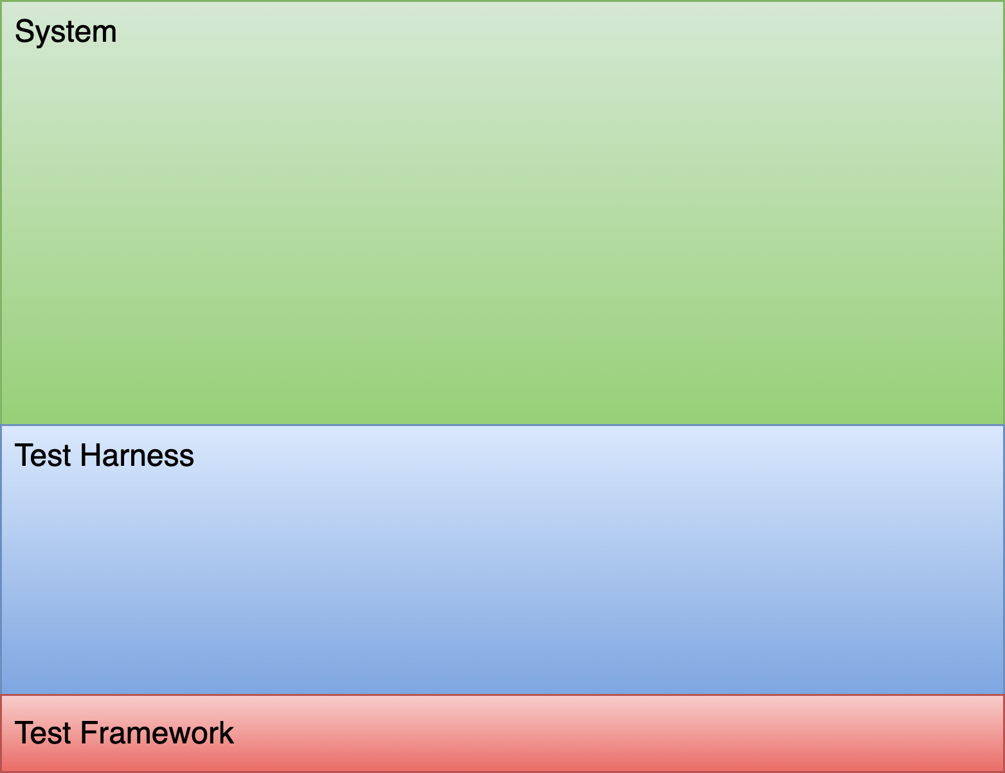
Methodology
Notes:
Script:
In order to properly undertake element instrumentation, it's critical to understand what's going on behind the scenes.
So, let's take a look and see what we're working with and how we're going to approach element instrumentation.
[pause]
First, we can talk about the system, which is simply the totality of the elements comprising the product.
Now, we're not going to perform dynamic analysis at the system level.
It's too large a scope to work with on either a practical level in terms of attempting to do the instrumentation, or on the outcome level as there would be too many issues to process.
[break]
So, we always talk about an individual element and scoping it to the smallest operational context that allows us to perform dynamic analysis.
When we think about dynamic analysis, it really isn't that much different from how we think about performing a unit test.
[pause]
We're going to have a test harness
[pause]
built on a test framework.
[break]
Lastly, we need an element-specific test.
In most cases, that’s all we need consider.
The element would be left as is just as if we were talking about something like fuzz testing, because what we're doing is we're feeding an element inputs and looking at behaviors and outputs to ensure that it's doing what it's supposed to do.
It's not just fuzz testing; unit tests also work this way.
In the case of dynamic analysis, we need to go a bit further.
[break]
We may need to instrument the element in order to perform dynamic analysis.
[break]
Additionally, dynamic analysis has one additional dependency and that is on runtime libraries.
Developers tend to focus on their own code and the external libraries they include, but underlying any executable are the runtime libraries that provides access to the hardware or operating system.
These are of interest in the context of dynamic analysis because they are responsible for things that are memory-related, which tend to be the ones that we care about in the context of cybersecurity.
Dynamic analysis is going to stress the element.
This might include things like memory starving the element to see how it behaves or tagging the allocated memory in order to observe how it responds over time to ensure that it's being accessed and disposed of properly.
[break]
To accomplish this, we need instrumented runtime libraries.
The use of instrumented libraries highlight why scoping matters.
If we scope to the entirety of the system for a memory-oriented dynamic analysis, and are tagging all the memory, or are causing pointers to be invalidated, or whatever else may be happening in the instrumented memory management library, that's going to have a severe impact on the overall behavior of the system.
So, when you're doing this instrumentation, we want to make sure that this is a test build (not a production build) and that it is scoped as tightly as possible because as one can imagine, any extra work that you're doing at the lowest level libraries is going to have a ripple effect throughout the executable that's being run.
We may or may not have to instrumentation directly into the element, but in all likelihood, dynamic analysis is going to require the use of instrumented libraries.
So, if there was any question as to whether or not you need DevOps involvement, this should motivate that participation.
In the worst case, we're going to need new build targets that include the instrument libraries to accompany the compiler-instrumented element.

Slide 10
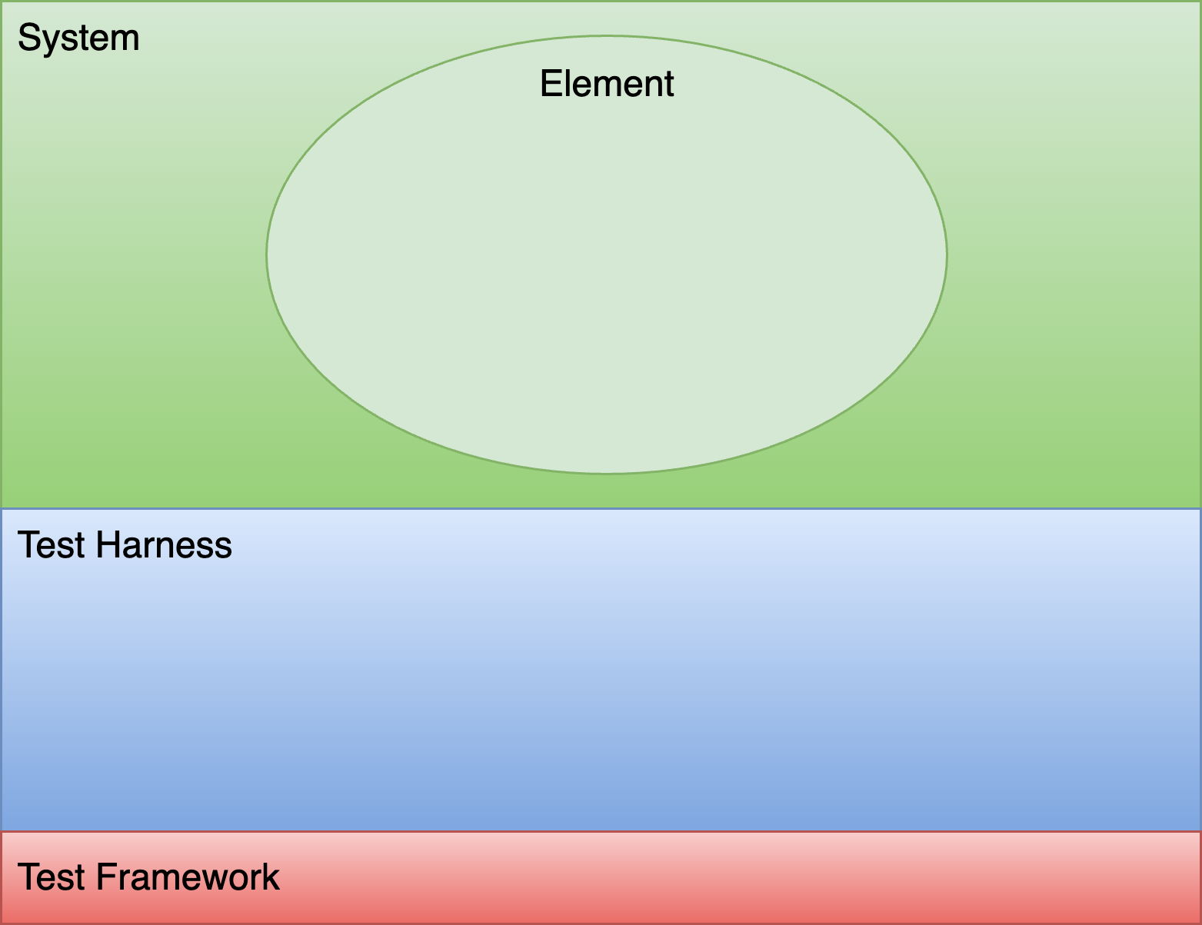
Methodology
Notes:
Script:
In order to properly undertake element instrumentation, it's critical to understand what's going on behind the scenes.
So, let's take a look and see what we're working with and how we're going to approach element instrumentation.
[pause]
First, we can talk about the system, which is simply the totality of the elements comprising the product.
Now, we're not going to perform dynamic analysis at the system level.
It's too large a scope to work with on either a practical level in terms of attempting to do the instrumentation, or on the outcome level as there would be too many issues to process.
[break]
So, we always talk about an individual element and scoping it to the smallest operational context that allows us to perform dynamic analysis.
When we think about dynamic analysis, it really isn't that much different from how we think about performing a unit test.
[pause]
We're going to have a test harness
[pause]
built on a test framework.
[break]
Lastly, we need an element-specific test.
In most cases, that’s all we need consider.
The element would be left as is just as if we were talking about something like fuzz testing, because what we're doing is we're feeding an element inputs and looking at behaviors and outputs to ensure that it's doing what it's supposed to do.
It's not just fuzz testing; unit tests also work this way.
In the case of dynamic analysis, we need to go a bit further.
[break]
We may need to instrument the element in order to perform dynamic analysis.
[break]
Additionally, dynamic analysis has one additional dependency and that is on runtime libraries.
Developers tend to focus on their own code and the external libraries they include, but underlying any executable are the runtime libraries that provides access to the hardware or operating system.
These are of interest in the context of dynamic analysis because they are responsible for things that are memory-related, which tend to be the ones that we care about in the context of cybersecurity.
Dynamic analysis is going to stress the element.
This might include things like memory starving the element to see how it behaves or tagging the allocated memory in order to observe how it responds over time to ensure that it's being accessed and disposed of properly.
[break]
To accomplish this, we need instrumented runtime libraries.
The use of instrumented libraries highlight why scoping matters.
If we scope to the entirety of the system for a memory-oriented dynamic analysis, and are tagging all the memory, or are causing pointers to be invalidated, or whatever else may be happening in the instrumented memory management library, that's going to have a severe impact on the overall behavior of the system.
So, when you're doing this instrumentation, we want to make sure that this is a test build (not a production build) and that it is scoped as tightly as possible because as one can imagine, any extra work that you're doing at the lowest level libraries is going to have a ripple effect throughout the executable that's being run.
We may or may not have to instrumentation directly into the element, but in all likelihood, dynamic analysis is going to require the use of instrumented libraries.
So, if there was any question as to whether or not you need DevOps involvement, this should motivate that participation.
In the worst case, we're going to need new build targets that include the instrument libraries to accompany the compiler-instrumented element.

Slide 11
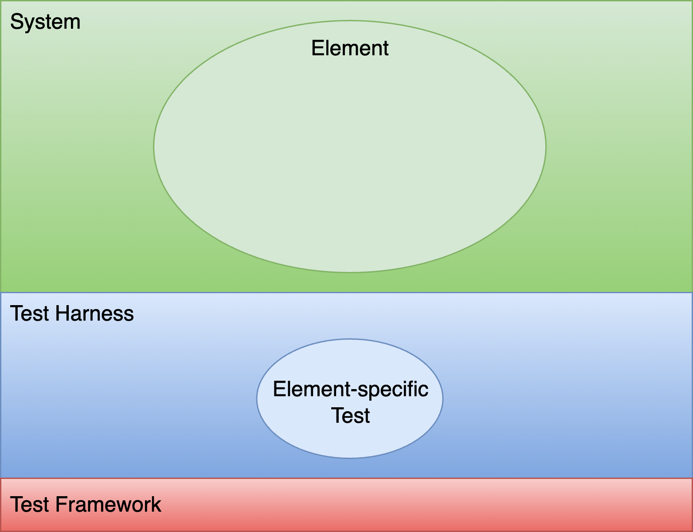
Methodology
Notes:
Script:
In order to properly undertake element instrumentation, it's critical to understand what's going on behind the scenes.
So, let's take a look and see what we're working with and how we're going to approach element instrumentation.
[pause]
First, we can talk about the system, which is simply the totality of the elements comprising the product.
Now, we're not going to perform dynamic analysis at the system level.
It's too large a scope to work with on either a practical level in terms of attempting to do the instrumentation, or on the outcome level as there would be too many issues to process.
[break]
So, we always talk about an individual element and scoping it to the smallest operational context that allows us to perform dynamic analysis.
When we think about dynamic analysis, it really isn't that much different from how we think about performing a unit test.
[pause]
We're going to have a test harness
[pause]
built on a test framework.
[break]
Lastly, we need an element-specific test.
In most cases, that’s all we need consider.
The element would be left as is just as if we were talking about something like fuzz testing, because what we're doing is we're feeding an element inputs and looking at behaviors and outputs to ensure that it's doing what it's supposed to do.
It's not just fuzz testing; unit tests also work this way.
In the case of dynamic analysis, we need to go a bit further.
[break]
We may need to instrument the element in order to perform dynamic analysis.
[break]
Additionally, dynamic analysis has one additional dependency and that is on runtime libraries.
Developers tend to focus on their own code and the external libraries they include, but underlying any executable are the runtime libraries that provides access to the hardware or operating system.
These are of interest in the context of dynamic analysis because they are responsible for things that are memory-related, which tend to be the ones that we care about in the context of cybersecurity.
Dynamic analysis is going to stress the element.
This might include things like memory starving the element to see how it behaves or tagging the allocated memory in order to observe how it responds over time to ensure that it's being accessed and disposed of properly.
[break]
To accomplish this, we need instrumented runtime libraries.
The use of instrumented libraries highlight why scoping matters.
If we scope to the entirety of the system for a memory-oriented dynamic analysis, and are tagging all the memory, or are causing pointers to be invalidated, or whatever else may be happening in the instrumented memory management library, that's going to have a severe impact on the overall behavior of the system.
So, when you're doing this instrumentation, we want to make sure that this is a test build (not a production build) and that it is scoped as tightly as possible because as one can imagine, any extra work that you're doing at the lowest level libraries is going to have a ripple effect throughout the executable that's being run.
We may or may not have to instrumentation directly into the element, but in all likelihood, dynamic analysis is going to require the use of instrumented libraries.
So, if there was any question as to whether or not you need DevOps involvement, this should motivate that participation.
In the worst case, we're going to need new build targets that include the instrument libraries to accompany the compiler-instrumented element.

Slide 12
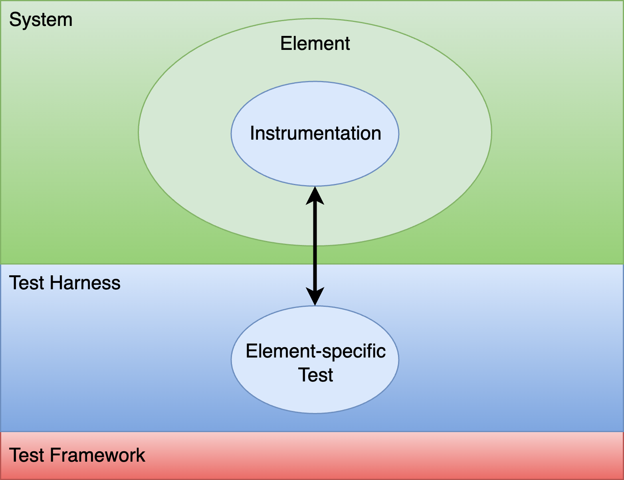
Methodology
Notes:
Script:
In order to properly undertake element instrumentation, it's critical to understand what's going on behind the scenes.
So, let's take a look and see what we're working with and how we're going to approach element instrumentation.
[pause]
First, we can talk about the system, which is simply the totality of the elements comprising the product.
Now, we're not going to perform dynamic analysis at the system level.
It's too large a scope to work with on either a practical level in terms of attempting to do the instrumentation, or on the outcome level as there would be too many issues to process.
[break]
So, we always talk about an individual element and scoping it to the smallest operational context that allows us to perform dynamic analysis.
When we think about dynamic analysis, it really isn't that much different from how we think about performing a unit test.
[pause]
We're going to have a test harness
[pause]
built on a test framework.
[break]
Lastly, we need an element-specific test.
In most cases, that’s all we need consider.
The element would be left as is just as if we were talking about something like fuzz testing, because what we're doing is we're feeding an element inputs and looking at behaviors and outputs to ensure that it's doing what it's supposed to do.
It's not just fuzz testing; unit tests also work this way.
In the case of dynamic analysis, we need to go a bit further.
[break]
We may need to instrument the element in order to perform dynamic analysis.
[break]
Additionally, dynamic analysis has one additional dependency and that is on runtime libraries.
Developers tend to focus on their own code and the external libraries they include, but underlying any executable are the runtime libraries that provides access to the hardware or operating system.
These are of interest in the context of dynamic analysis because they are responsible for things that are memory-related, which tend to be the ones that we care about in the context of cybersecurity.
Dynamic analysis is going to stress the element.
This might include things like memory starving the element to see how it behaves or tagging the allocated memory in order to observe how it responds over time to ensure that it's being accessed and disposed of properly.
[break]
To accomplish this, we need instrumented runtime libraries.
The use of instrumented libraries highlight why scoping matters.
If we scope to the entirety of the system for a memory-oriented dynamic analysis, and are tagging all the memory, or are causing pointers to be invalidated, or whatever else may be happening in the instrumented memory management library, that's going to have a severe impact on the overall behavior of the system.
So, when you're doing this instrumentation, we want to make sure that this is a test build (not a production build) and that it is scoped as tightly as possible because as one can imagine, any extra work that you're doing at the lowest level libraries is going to have a ripple effect throughout the executable that's being run.
We may or may not have to instrumentation directly into the element, but in all likelihood, dynamic analysis is going to require the use of instrumented libraries.
So, if there was any question as to whether or not you need DevOps involvement, this should motivate that participation.
In the worst case, we're going to need new build targets that include the instrument libraries to accompany the compiler-instrumented element.

Slide 13
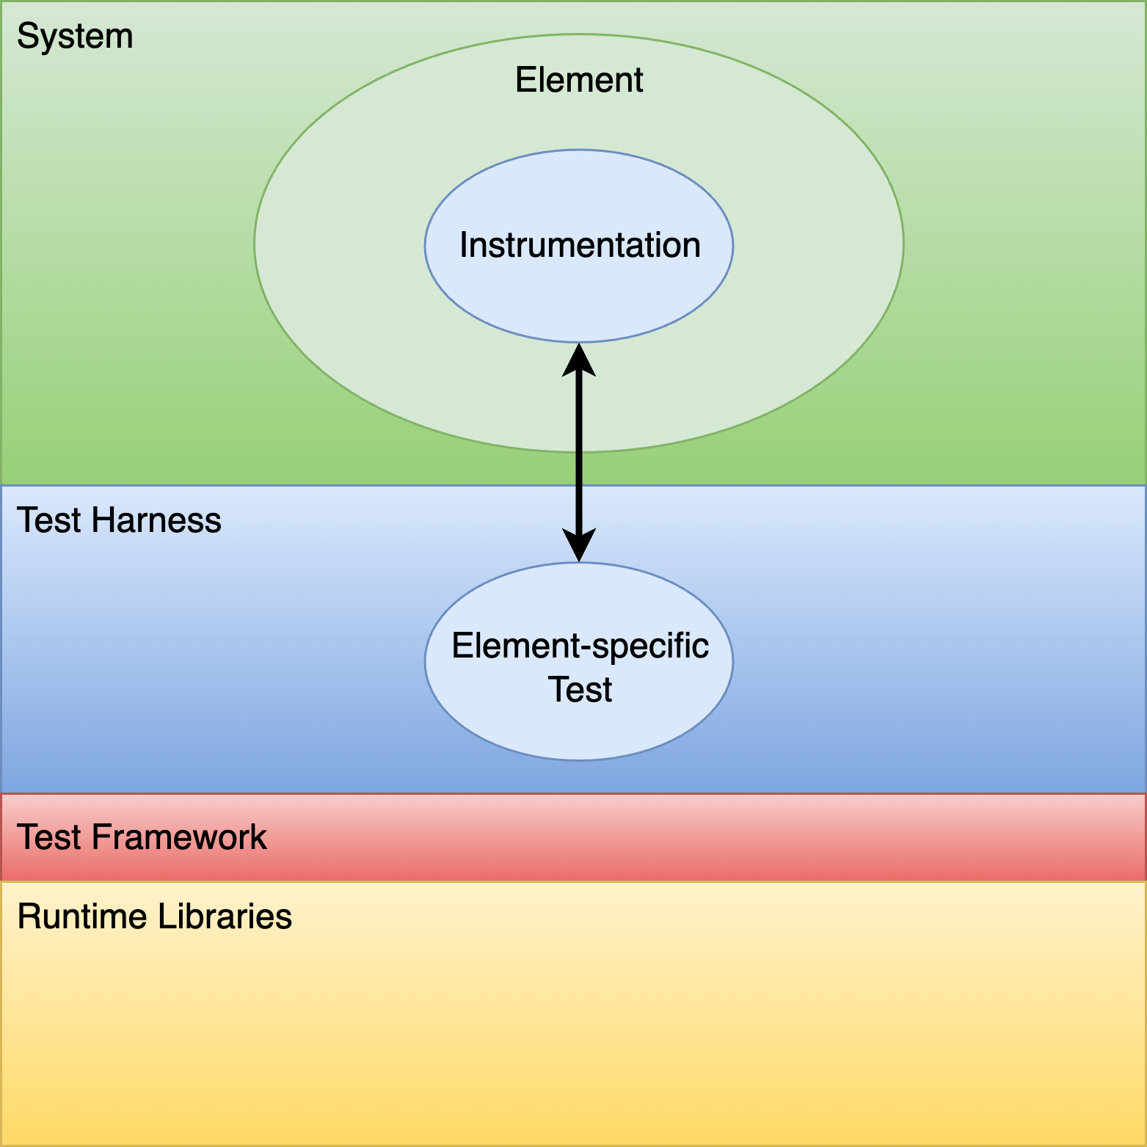
Methodology
Notes:
Script:
In order to properly undertake element instrumentation, it's critical to understand what's going on behind the scenes.
So, let's take a look and see what we're working with and how we're going to approach element instrumentation.
[pause]
First, we can talk about the system, which is simply the totality of the elements comprising the product.
Now, we're not going to perform dynamic analysis at the system level.
It's too large a scope to work with on either a practical level in terms of attempting to do the instrumentation, or on the outcome level as there would be too many issues to process.
[break]
So, we always talk about an individual element and scoping it to the smallest operational context that allows us to perform dynamic analysis.
When we think about dynamic analysis, it really isn't that much different from how we think about performing a unit test.
[pause]
We're going to have a test harness
[pause]
built on a test framework.
[break]
Lastly, we need an element-specific test.
In most cases, that’s all we need consider.
The element would be left as is just as if we were talking about something like fuzz testing, because what we're doing is we're feeding an element inputs and looking at behaviors and outputs to ensure that it's doing what it's supposed to do.
It's not just fuzz testing; unit tests also work this way.
In the case of dynamic analysis, we need to go a bit further.
[break]
We may need to instrument the element in order to perform dynamic analysis.
[break]
Additionally, dynamic analysis has one additional dependency and that is on runtime libraries.
Developers tend to focus on their own code and the external libraries they include, but underlying any executable are the runtime libraries that provides access to the hardware or operating system.
These are of interest in the context of dynamic analysis because they are responsible for things that are memory-related, which tend to be the ones that we care about in the context of cybersecurity.
Dynamic analysis is going to stress the element.
This might include things like memory starving the element to see how it behaves or tagging the allocated memory in order to observe how it responds over time to ensure that it's being accessed and disposed of properly.
[break]
To accomplish this, we need instrumented runtime libraries.
The use of instrumented libraries highlight why scoping matters.
If we scope to the entirety of the system for a memory-oriented dynamic analysis, and are tagging all the memory, or are causing pointers to be invalidated, or whatever else may be happening in the instrumented memory management library, that's going to have a severe impact on the overall behavior of the system.
So, when you're doing this instrumentation, we want to make sure that this is a test build (not a production build) and that it is scoped as tightly as possible because as one can imagine, any extra work that you're doing at the lowest level libraries is going to have a ripple effect throughout the executable that's being run.
We may or may not have to instrumentation directly into the element, but in all likelihood, dynamic analysis is going to require the use of instrumented libraries.
So, if there was any question as to whether or not you need DevOps involvement, this should motivate that participation.
In the worst case, we're going to need new build targets that include the instrument libraries to accompany the compiler-instrumented element.

Slide 14
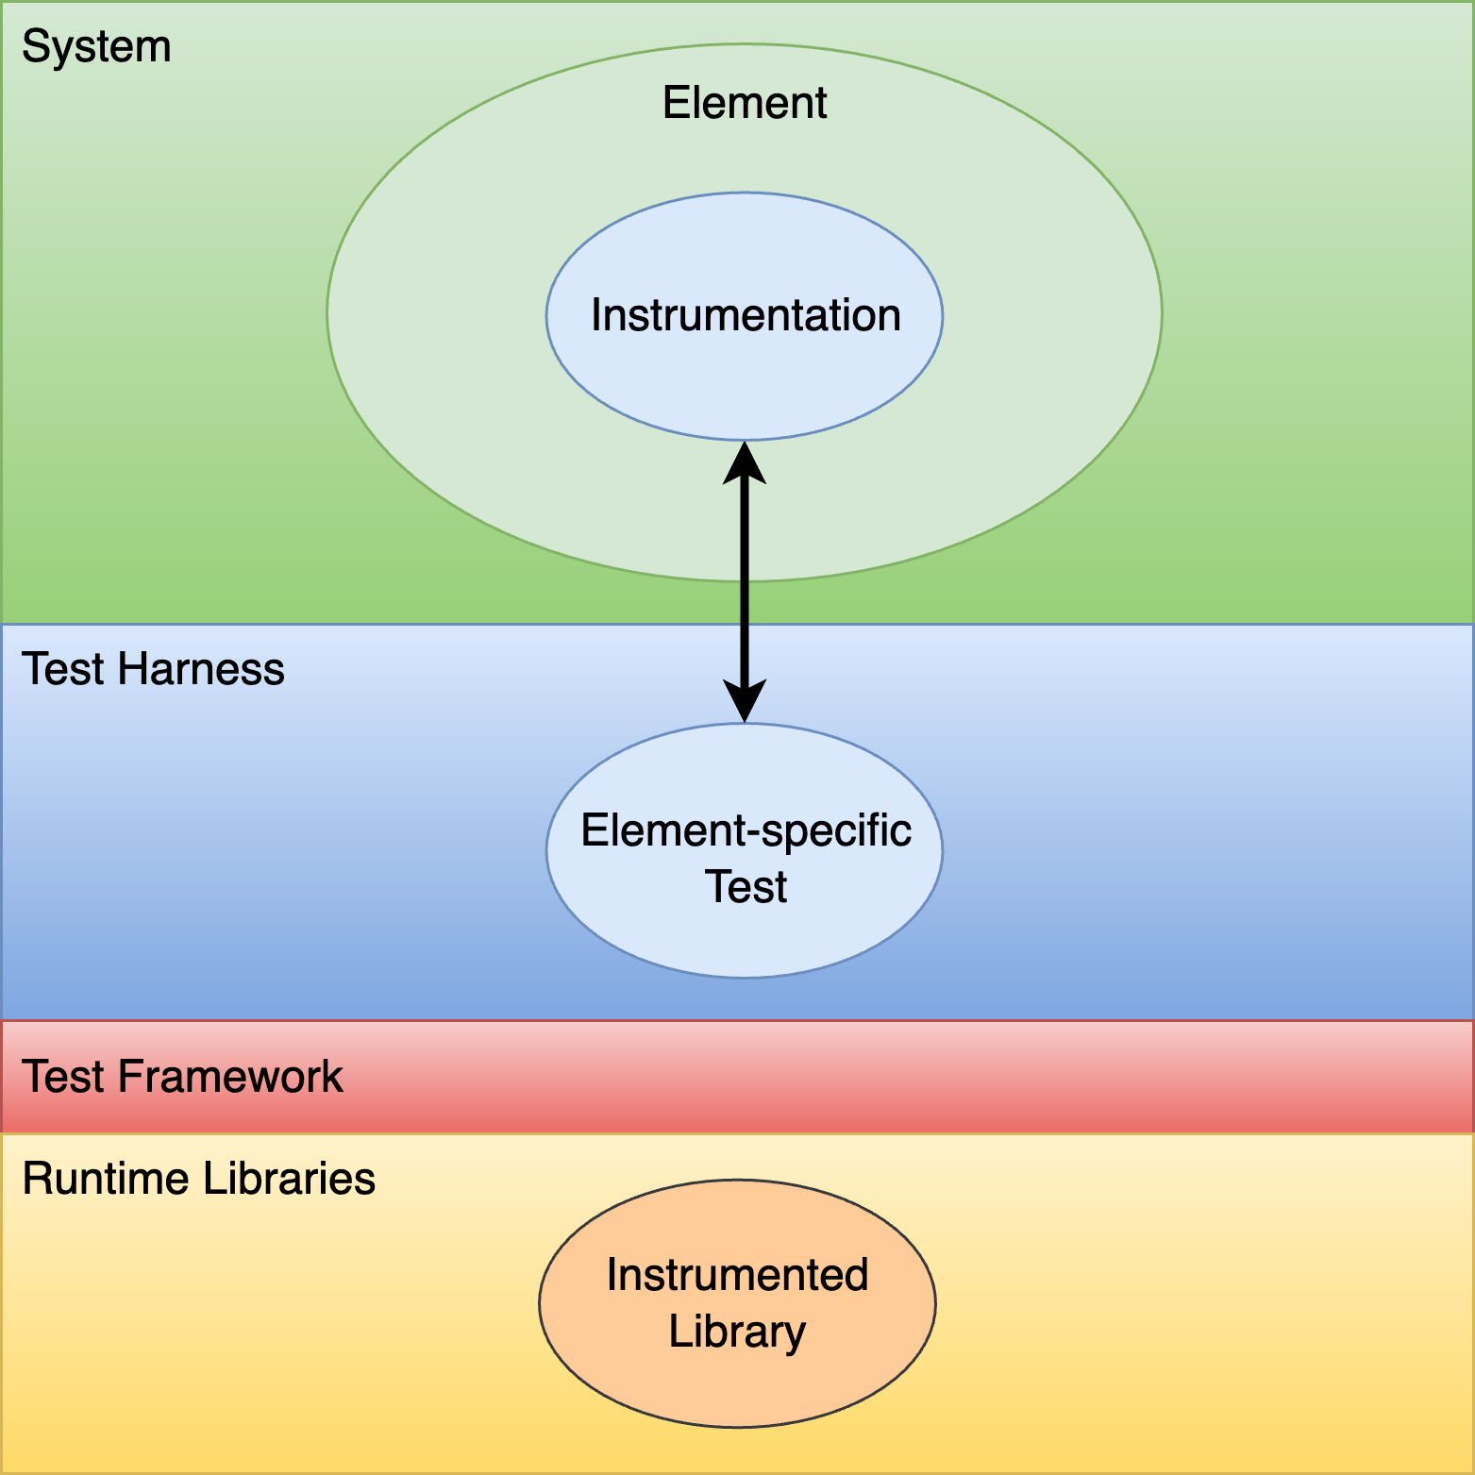
Methodology
Notes:
Script:
In order to properly undertake element instrumentation, it's critical to understand what's going on behind the scenes.
So, let's take a look and see what we're working with and how we're going to approach element instrumentation.
[pause]
First, we can talk about the system, which is simply the totality of the elements comprising the product.
Now, we're not going to perform dynamic analysis at the system level.
It's too large a scope to work with on either a practical level in terms of attempting to do the instrumentation, or on the outcome level as there would be too many issues to process.
[break]
So, we always talk about an individual element and scoping it to the smallest operational context that allows us to perform dynamic analysis.
When we think about dynamic analysis, it really isn't that much different from how we think about performing a unit test.
[pause]
We're going to have a test harness
[pause]
built on a test framework.
[break]
Lastly, we need an element-specific test.
In most cases, that’s all we need consider.
The element would be left as is just as if we were talking about something like fuzz testing, because what we're doing is we're feeding an element inputs and looking at behaviors and outputs to ensure that it's doing what it's supposed to do.
It's not just fuzz testing; unit tests also work this way.
In the case of dynamic analysis, we need to go a bit further.
[break]
We may need to instrument the element in order to perform dynamic analysis.
[break]
Additionally, dynamic analysis has one additional dependency and that is on runtime libraries.
Developers tend to focus on their own code and the external libraries they include, but underlying any executable are the runtime libraries that provides access to the hardware or operating system.
These are of interest in the context of dynamic analysis because they are responsible for things that are memory-related, which tend to be the ones that we care about in the context of cybersecurity.
Dynamic analysis is going to stress the element.
This might include things like memory starving the element to see how it behaves or tagging the allocated memory in order to observe how it responds over time to ensure that it's being accessed and disposed of properly.
[break]
To accomplish this, we need instrumented runtime libraries.
The use of instrumented libraries highlight why scoping matters.
If we scope to the entirety of the system for a memory-oriented dynamic analysis, and are tagging all the memory, or are causing pointers to be invalidated, or whatever else may be happening in the instrumented memory management library, that's going to have a severe impact on the overall behavior of the system.
So, when you're doing this instrumentation, we want to make sure that this is a test build (not a production build) and that it is scoped as tightly as possible because as one can imagine, any extra work that you're doing at the lowest level libraries is going to have a ripple effect throughout the executable that's being run.
We may or may not have to instrumentation directly into the element, but in all likelihood, dynamic analysis is going to require the use of instrumented libraries.
So, if there was any question as to whether or not you need DevOps involvement, this should motivate that participation.
In the worst case, we're going to need new build targets that include the instrument libraries to accompany the compiler-instrumented element.

Slide 15
Dynamic Analysis Best Practices
Notes:
Script:
Now, let's highlight some dynamic analysis best practices.

Slide 16
Best Practices
Start small
Keep tests separate
Avoid high-churn elements
Avoid duplicating coverage areas
Notes:
Script:
As mentioned earlier and emphasized several times, we want to start small because dynamic analysis is a stressor to the system, you should focus on the smallest necessary part that you have and work from there.
Once a construct that's managing a resource, typically, has been dealt with, then you can build upon that.
So, taking a compositional approach is a reasonable one.
[pause]
You should have logical separation between the tests.
A dynamic analysis test that’s stressing two separable elements will, to some extent, expose issues with their interplay.
If you've already dealt with them individually, then that’s fine, but you have to start by dealing with each separately.
The importance of this will be covered again in the runtime considerations discussion.
[pause]
Next, avoid high-churn elements.
If there's an element that is under active development and is changing at a fairly rapid rate, then dynamic analysis is probably not what you want to apply to it, because it’s not in a stable state.
[pause]
And finally, you should avoid replicating test coverage.
When there is automated tooling in use which addresses the same cybersecurity-relevant issues, those issues should be addressed before applying dynamic analysis.

Slide 17
Runtime Considerations
Notes:
Script:
Finally, let's consider some runtime aspects that are going to influence how we're doing dynamic analysis.

Slide 18
Considerations
Termination on error
Issue occlusion
Footprint
Cybersecurity side-effects
Notes:
Script:
Some dynamic analysis tools terminate when an error is detected.
Others can be configured to do so.
This behavior which although providing us actionable results, because a crash is a crash, may be difficult to replicate because of sensitivity to initial conditions.
Additionally, this may slow the rate at which issues are identified.
The alternative requires the addition of error state handling when testing is performed within a CI/CD pipeline.
[pause]
The second consideration is that of issue occlusion.
When you're dealing with things related to memory and address, if you determine that an error condition is present, then arguably, the system is in a compromised state, and any further analysis would not be prudent.
However, if one just takes that approach, then you can end up masking other things that might be more significant and so, one should consider whenever you find an error, to not necessarily ignore everything and then address that one directly, but rather to rework the tests in order to suppress that error, so that you can determine if there's anything else which may be underlying the error that's been detected.
Issues may also be occluded by the abovementioned termination on error behavior and also tooling which has finding limits.
[pause]
The third consideration is that of footprint.
Now, we talked about footprint before, but in light of the discussion on runtime libraries, it becomes more obvious how footprint comes into play here.
In the case of memory-oriented dynamic analysis, you have instrumentation which is putting guards around allocated memory, and detection logic checking allocations, de-allocations and accesses.
This can dramatically increase executable size and execution time compared to the baseline.
[pause]
Finally, the cybersecurity side-effects of doing this instrumentation cannot be overstated.
Whether instrumentation tags memory or adds explicit checks to memory access, it has to be done in a way which is visible to the test harness.
The resultant code would probably trigger any cybersecurity checks being done against the system by other external tools.
This is yet another reason to not perform dynamic analysis at the system level.

Slide 19
Recap
Notes:
Script:
That covers our treatment of the element instrumentation activity within the dynamic analysis process.
Now let's look at some takeaways.

Slide 20
Summary
Take an incremental approach
Concentrate on the critical elements
Don’t replicate analysis performed by other tools
Be mindful of analysis constraints and impacts
Notes:
Script:
As you're approaching element instrumentation.
Take an incremental approach, both in scope and in what you're trying to look at simultaneously.
[pause]
Concentrate on the critical elements.
This goes along with the scope but is more focused.
Remember that dynamic analysis is an expensive process, relatively speaking, and if you have elements that just aren't critical, then do those later.
[pause]
Don't replicate the analysis that you're getting out of other tools because, again, dynamic analysis is probably the most expensive option, in terms of setup, execution, and speed to detection.
[pause]
Finally, be mindful of what the dynamic analysis constraints and impacts are.
It's really important that you allow for the time, resource, and external tool impacts that may occur during dynamic analysis.

Slide 21
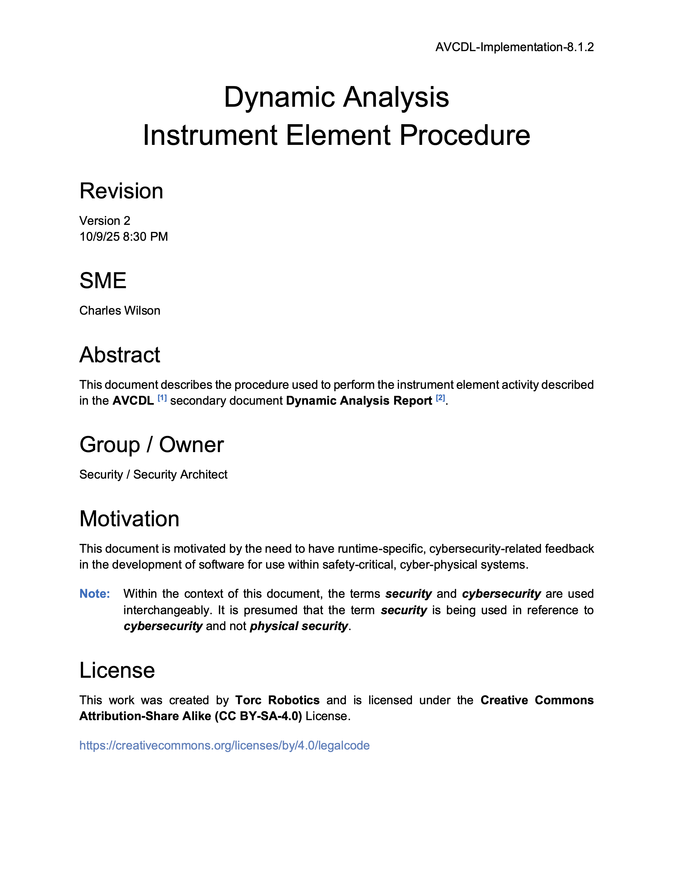
Further Reading
Notes:
Script:
For additional information and to get a more in-depth set of references, the Dynamic Analysis Instrument Element Procedure tertiary document is available in the AVCDL GitHub repository.

Slide 22
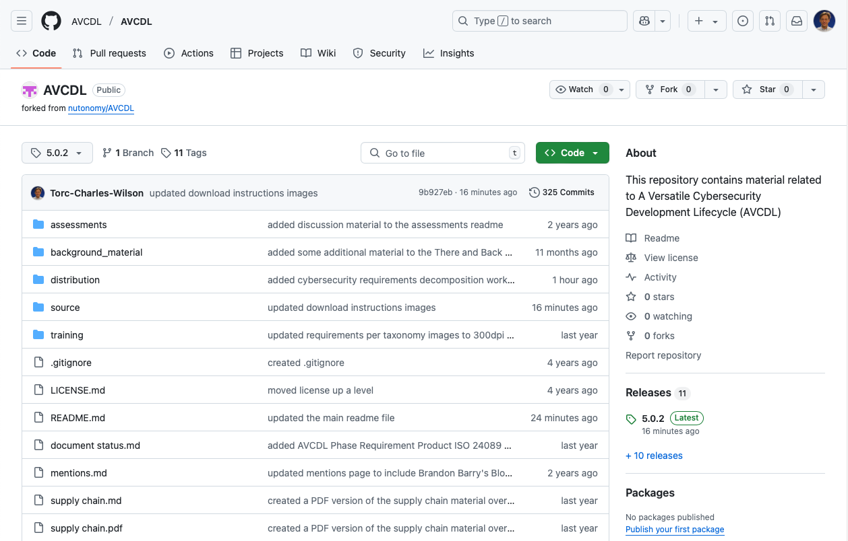
AVCDL on GitHub
https://github.com/AVCDL/AVCDL
Notes:
Script:
All AVCDL materials, both in source and distribution forms, are available on our GitHub site, as shown here.
Because of the size of the repository, it's recommended that you either clone the repository or download a ZIP archive of it, if you're not familiar with using git.
Instructions for downloading a ZIP archive are linked to on the repository’s front page.

Slide 23
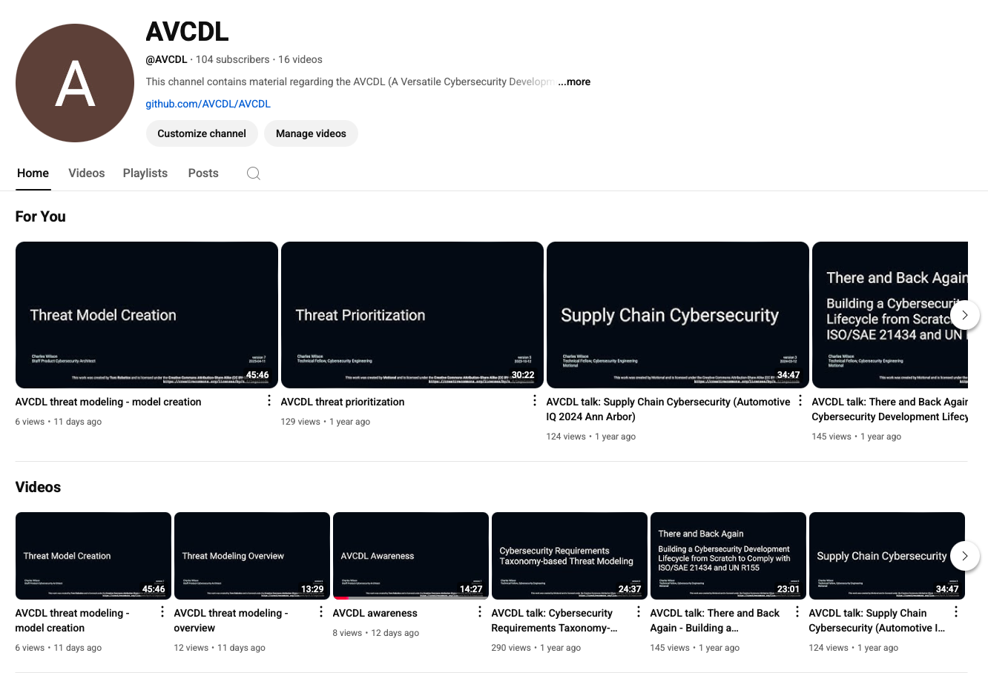
AVCDL on YouTube
https://youtube.com/@AVCDL
Notes:
Script:
Videos covering various aspects of the AVCDL are available on our YouTube channel, as shown here.
It's important to note that all AVCDL materials with the exception of the introductory blog posts are intended for product cybersecurity engineering practitioners.

Slide 24
Next Steps
Notes:
Script:
With this training complete, if you’ve completed the other trainings covering the Dynamic Analysis process activities, you can proceed to the other trainings at this level, these include:
Static Analysis
Fuzz Testing
and
Secure Code Review

Slide 25
References
AVCDL primary document
Dynamic Analysis Report (AVCDL secondary document)
Dynamic Analysis Establish Settings Procedure (AVCDL tertiary document)
Dynamic Analysis Instrument Settings Procedure (AVCDL tertiary document)
Google Sanitizers GitHub (archive)
https://github.com/google/sanitizers
ASanity: On Bug Shadowing by Early ASan Exits
https://wootconference.org/papers/woot23-paper34.pdf
Notes:
Script:
Here are the references to the source material used in the creation of this presentation.
They'll also be included in the video description.
Additionally, this presentation’s source material will be provided on the AVCDL GitHub repository.

